Slide 1
Task 3 - Dashboard Design
📊 Objective:
To design a Power BI dashboard that reveals financial performance trends across various sectors and companies.
Presented by
Purnakam Shrivastava
Data Analyst
Elevate Labs
June
2025

Slide 2
Content
1
Dataset Overview
2
Power BI Dashboard Highlights
3
KPI Summary
4
Sector-Wise Analysis
5
Company Spotlight – Top Performers
6
Strategic Insights & Recommendations
Elevate Labs
June
2025

Slide 3
1
Dataset Overview
📄 Key Financial Metrics Extracted:
🧩 Data Source:
Metric | Description
ROE (%) | Return on Equity – Profitability Metric
Net Income ($M) | Profit after taxes
Revenue ($M) | Total income generated
Free Cash Flow ($B) | Cash available after CapEx
Market Cap ($B) | Company Valuation
D/E Ratio | Debt-to-Equity Ratio – Risk Indicator
CSV / Excel File with static company data.
👀 Data Cleaning Highlights:
Converted object types to numeric.
Removed missing/irrelevant entries.
Calculated industry-wise averages.
Elevate Labs
June
2025

Slide 4
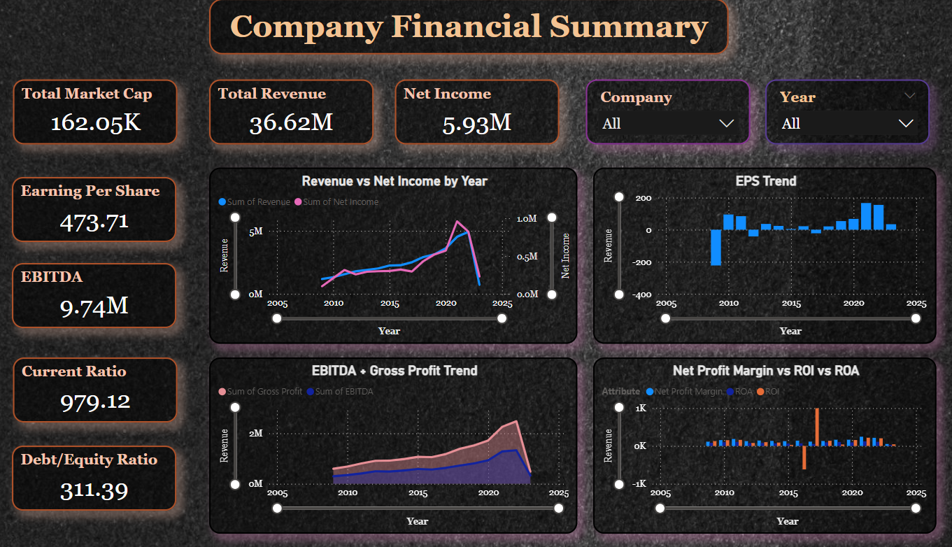
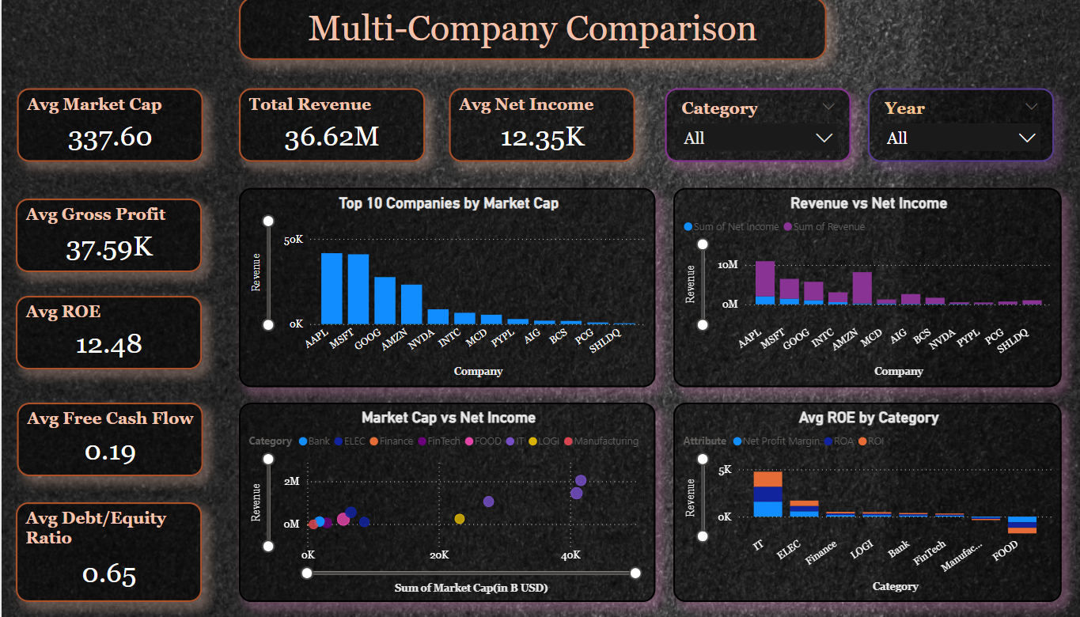
2
Power BI Dashboard Highlights
🔍 Key Visual Elements:
KPI Cards: Avg ROE, Revenue, Net Income, Market Cap
Bar Chart: ROE by Industry
Table: Company-wise Financial Summary
Scatter Plot: Revenue vs Net Income
Filters: Industry Slicer
Elevate Labs
June
2025

Slide 5
3
KPI Summary
📄 Key Financial Metrics Extracted:
🎯 Interpretation:
Metric | Value
Avg ROE | 12.48%
Avg Market Cap | $337.60 B
Total Revenue | $36.63 M
Avg Net Income | $12.35 M
Avg FCF | $0.19 B
Avg D/E Ratio | 0.65
Companies maintain positive income & FCF overall.
D/E Ratio is low, suggesting less debt burden.
ROE is skewed due to high outliers in IT/Electronics.
Elevate Labs
June
2025

Slide 6
📊 D/E Ratio by Industry:
4
Sector-Wise Analysis
Industry | D/E Ratio
Finance | 1.75
Manufacturing | 0.78
IT | 0.21
📊 ROE by Industry :
Industry | ROE (%)
IT | 1583.77
Electronics | 565.47
Finance | 19.67
Manufacturing | -53.84
Food | -35.77
🧠 Insight:
IT & Electronics dominate in ROE and cash flow.
Food & Manufacturing sectors face financial instability.
Elevate Labs
June
2025

Slide 7
5
Company Spotlight – Top Performers
📊 ROE by Industry :
Company | ROE (%) | Net Income ($M) | Revenue ($M) | Market Cap ($B)
AAPL | 175.84 | 11.96 | 17.69 | 749.22
MSFT | 100.27 | 10.69 | 15.78 | 746.78
GOOG | 78.72 | 9.83 | 18.16 | 556.57
AMZN | 18.34 | 2.71 | 33.00 | 530.58
📌 Takeaways:
AAPL & MSFT have exceptional ROE & Market Cap.
AMZN leads in revenue, but not ROE.
Some companies report negative income, flagging risk.
Elevate Labs
June
2025

Slide 8
6
Strategic Insights & Recommendations
💼 For Investors:
📊 For Analysts:
Prioritize IT/Electronics for higher returns.
Watch out for companies with negative ROE or income.
Use multi-metric approach: ROE, FCF, D/E for holistic evaluation.
Rely on interactive visuals for deeper industry trends.
📈 For Executives:
Focus on debt optimization and profitability growth.
Compare peer ROE and D/E benchmarks to improve positioning.
Elevate Labs
June
2025

Slide 9
Thank you
Elevate Labs
June
2025

